Slide 1
RECURSION
ASUU(Academic Staff Union of Universities) called on a Strike that called on a Strike that called on a Strike.
Hope it has an end!
Adelaja Qowiyyu
adexolamilekan46@gmail.com

Slide 2
What is Recursion?
Recursion is a problem solving technique of using several smaller solutions to implement the big solution to a problem.
It is a divide and conquer problem solving technique.
It is implemented by having a function call itself.
It must have a Recursive Case which calls the next function (same function) with a different input.
It must have a base case (terminating condition).
NB: SAME FUNCTION DOESN’T MEAN SAME FUNCTION INSTANCE

Slide 3
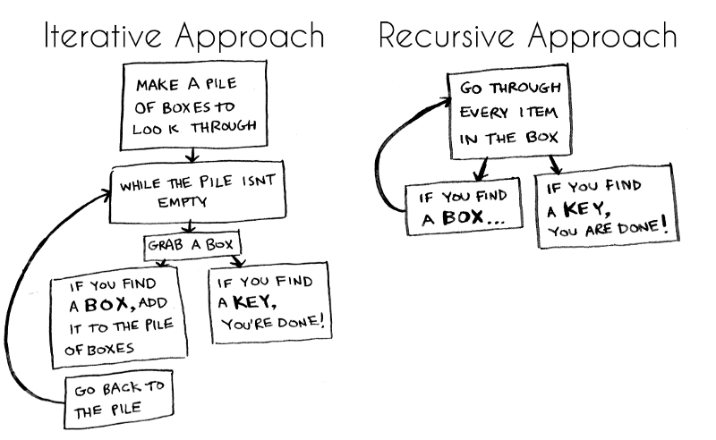
Need for Recursion?
A simpler and more concise way to solve a problem that can be solved using subtask of the same step(s) but different input.
Image Credit: https://www.freecodecamp.org/

Slide 4
How Recursive Functions Work?
Functions are assigned a memory in the stack when called.
The initial function remains in the stack while it calls another function (it’s duplicate) with a different input.
The duplicate function gets assigned memory in the stack and if it’s input does not satisfy the base case, it also remains in the stack while it calls another function (its duplicate) with a different input.
This continues until a function is called whose input satisfies the base case.
Once the base case is reached, all the function in the stack are stepped into in the Last-In-First-Out (backward) order - to complete their execution or return a value.
For example: A recursive function that has 4 functions in the stack will be returned or executed in the order 4th function, 3rd function, 2nd function …

Slide 5
Focus in Writing a Recursive Function
You should ask yourself these questions:
Base case: What is the terminating condition for this problem.?
For example: In a Fibonacci problem it would be when you get to an input of 1
Recursive case: What is the repeated operation in solving this problem?

Slide 6
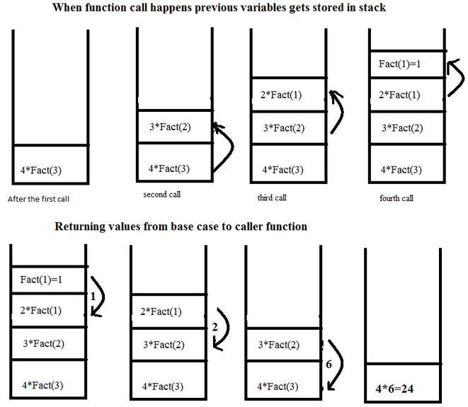
Recursive Function Call Stack?

Slide 7
Applications of Recursion
To compute Factorial of a number.
To compute power of a number.
To determine if a word is a palindrome.
To draw a fractal.
To solve the ancient Tower of Hanoi problem.

Slide 8

Disadvantage of Recursion
The stack being a limited resource can be easily overfilled leading to a stackoverflow.

Slide 9
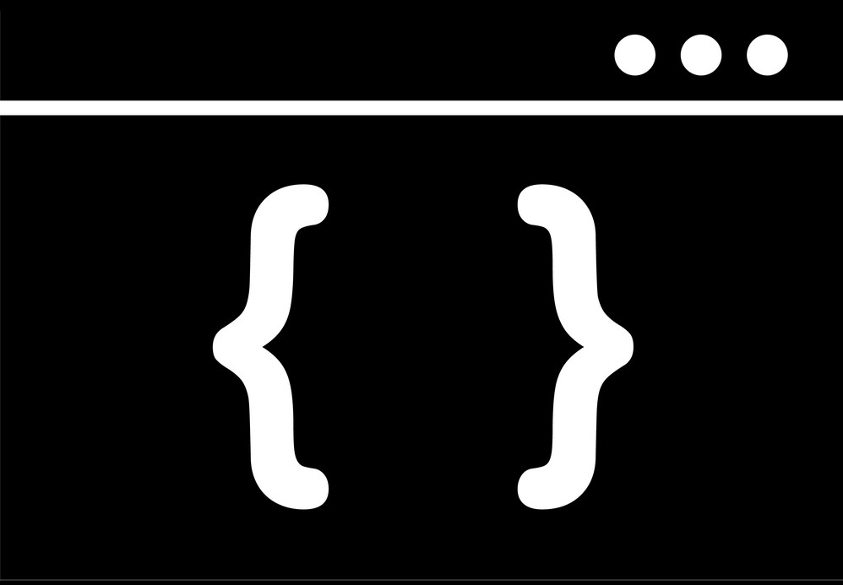
PRACTICAL SESSION…

Slide 10

Questions?

Slide 11


Thank you!
Let’s connect
https://www.linkedin.com/in/qowiyyuadelaja/
https://github.com/adelajaOlamilekan

